Slide 1
The Corporation and
Its Stakeholders
Chapter 1
McGraw-Hill/Irwin
Copyright © 2014 by The McGraw-Hill Companies, Inc. All rights reserved.

Slide 2
Ch. 1: Key Learning Objectives
Understanding the relationship between business and society, and the ways in which they are part of an interactive system
Considering the purpose of the modern corporation
Knowing what is a stakeholder and who a corporation’s market and nonmarket and internal and external stakeholders are
Conducting a stakeholder analysis, and understanding the basis of stakeholder interests and power
Recognizing the diverse ways in which modern corporations organize internally to interact with various stakeholders
Analyzing the forces of change that continually reshape the business and society relationship
1-<number>

Slide 3
Introduction –
The Business and Society Relationship
Business: Any organization that is engaged in making a product or providing a service for a profit
Society: Human beings and the social structures they collectively create
Business and society are highly interdependent
1-<number>

Slide 4
Introduction –
The Business and Society Relationship
We borrow “General Systems Theory (GST)” from biology to explain this relationship; first introduced in 1940s
  Theory posits that organisms cannot be understood in isolation, even though they have clear boundaries; they can only be understood in relationship to their surroundings
Adapted to management theory means that business firms are embedded in a broader social environment with which they constantly interact
  Business and society together form an interactive social system (shown graphically in the following slide)
1-<number>

Slide 5
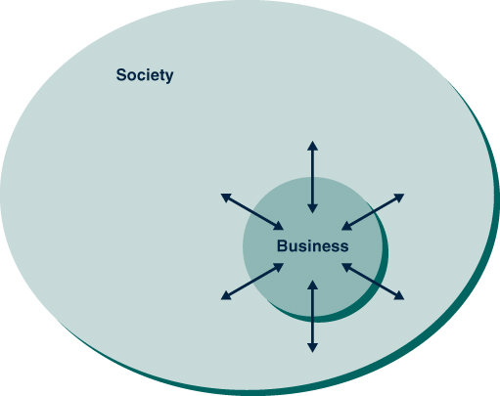
Business and Society:
An Interactive System
Figure 1.1
1-<number>

Slide 6
Two critical questions:
What is the purpose of the modern corporation?
To whom, or what, should the firm be responsible?
1-<number>

Slide 7
Two contrasting views:
“Ownership Theory of the Firm” (also called property or finance theory)
  The firm is seen as the property of its owners (shareholders)
  Argues the owners’ interests are paramount and take precedence over the interests of others
  The purpose of the firm is to maximize its long-term market value, that is, to make the most money it can for shareholders
1-<number>

Slide 8
“Stakeholder Theory of the Firm”
Argues the corporation serves a broader purpose, to create value for society
Must make profit for owners to survive, however, creates other kinds of value too
Corporations have multiple obligations, all “stakeholder” groups must be taken into account
1-<number>

Slide 9
Core Arguments for
Stakeholder Theory of the Firm
  Descriptive
    More realistic description of how companies really work
  Instrumental
    More effective corporate strategy
  Normative
    Stakeholder management is the right thing to do
1-<number>

Slide 10
The Stakeholder Concept
A stakeholder refers to persons or groups that affect, or are affected by, an organization’s decisions, policies, and operations
A stake is an interest in–or claim on–a business enterprise
Businesses are embedded in networks that involve many groups with such a stake
1-<number>

Slide 11
The Stakeholder Concept:
A Tip for Understanding
Term stakeholder is NOT the same as stockholder
Words sound similar BUT are not the same
Stockholders are one of several kinds of stakeholders
1-<number>

Slide 12
Different Kinds of Stakeholders
Stakeholder groups can be divided into two categories:
  Market stakeholders
  Nonmarket stakeholders
1-<number>

Slide 13
Market Stakeholders
Market stakeholders are those that engage in economic transactions with the company as it carries out its primary purpose of providing society with goods and services
1-<number>

Slide 14
Nonmarket Stakeholders
Nonmarket stakeholders are people or groups who—although they do not engage in direct economic exchange with the firm—are affected by or can affect its actions
1-<number>

Slide 15
Further Distinction
Internal stakeholders are those, such as employees and managers, who are employed by the firm
  They are “inside” the firm, in the sense that they contribute their effort and skill, usually at a company worksite
External stakeholders are those who—although they may have important transactions with the firm—are not directly employed by it
1-<number>

Slide 16
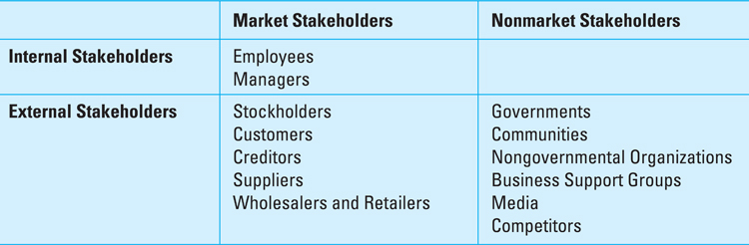
The Stakeholders of Business
Figure 1.2
1-<number>

Slide 17
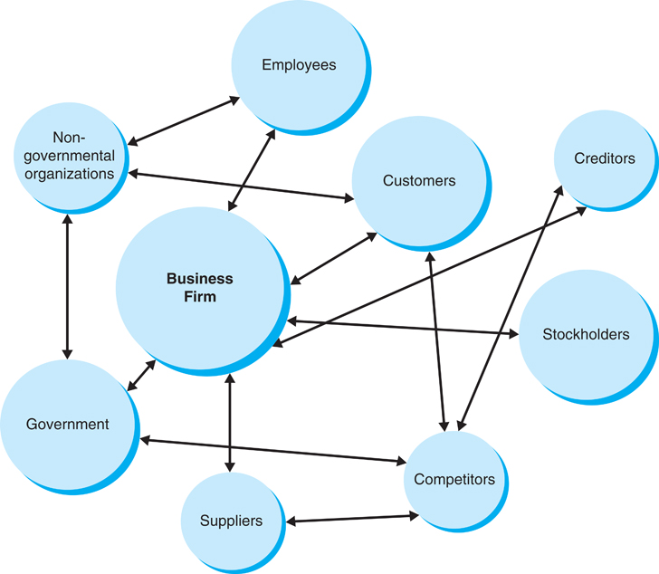
Figure 1.3
A Firm and Its Stakeholders
1-<number>

Slide 18
Stakeholder Analysis
It is part of every manager’s job
Process whereby identify relevant stakeholders and analyze their interest and power
Asks 4 questions:
  Who are the relevant stakeholders?
  What are the interests of each stakeholder?
  What is the power of each stakeholder?
  How are coalitions likely to form?
1-<number>

Slide 19
Stakeholder Analysis – Question 1
Who are the Relevant Stakeholders?
Answer this question by drawing market and nonmarket stakeholder maps
Recognize that not all of groups are relevant to every situation
  Examples:
    Some businesses sell directly to the public and will not have retailers
    A certain stakeholder may not be relevant to a particular decision/action
1-<number>

Slide 20
Stakeholder Analysis – Question 2
What are the interests of each stakeholder?
Analyzing stakeholder interests includes addressing:
  What are the groups’ concerns?
  What does the group want/expect from their relationship with the firm?
Examples:
  Stockholders have an ownership interest, they expect to receive dividends and capital appreciation
  Customers are interested in gaining fair value and quality in goods and services they purchase
  Public interest groups advance broad social interests
1-<number>

Slide 21
Stakeholder Analysis – Question 3
What is the power of each stakeholder?
Stakeholder power is the ability of a group to use resources to make an event happen or to secure a desired outcome
There are 4 types of stakeholder power:
  Voting power
  Economic power
  Political power
  Legal power
  Informational power
1-<number>

Slide 22
Stakeholder Analysis – Question 4
How are stakeholder coalitions likely to form?
Stakeholder groups often have common interests and will form temporary alliances to pursue these common interests
Coalitions are very dynamic (can change at any time)
Coalitions are increasing international
Internet has enabled coalitions to form quickly, across political boundaries
International alliances, coupled with media interest, can be a very powerful strategic force for companies
1-<number>

Slide 23
Stakeholder Salience and Mapping
Salient – stands out from a background, is seen as important, or draws attention
Stakeholders stand out (i.e., are salient) to managers when they have power, legitimacy, and urgency
Managers can use the salience concept to develop a stakeholder map – a graphical representation of the relationship of stakeholder salience to a particular issue
A stakeholder map is a useful tool, because it enables managers to see quickly how stakeholders feel about an issue
1-<number>

Slide 24
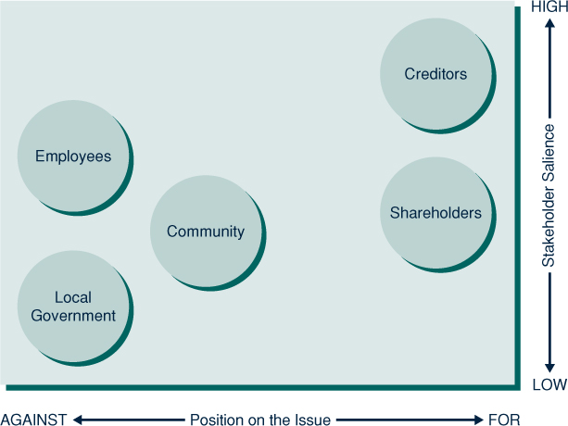
Figure 1.4
Stakeholder Map
1-<number>

Slide 25
The Corporation’s
Boundary-Spanning Departments
Boundary-spanning departments (shown graphically in the following slide) – departments or offices within an organization that reach across the dividing line that separates the company from groups and people in society
Building positive and mutually beneficial relationships across organizational boundaries is a growing part of management’s role
1-<number>

Slide 26
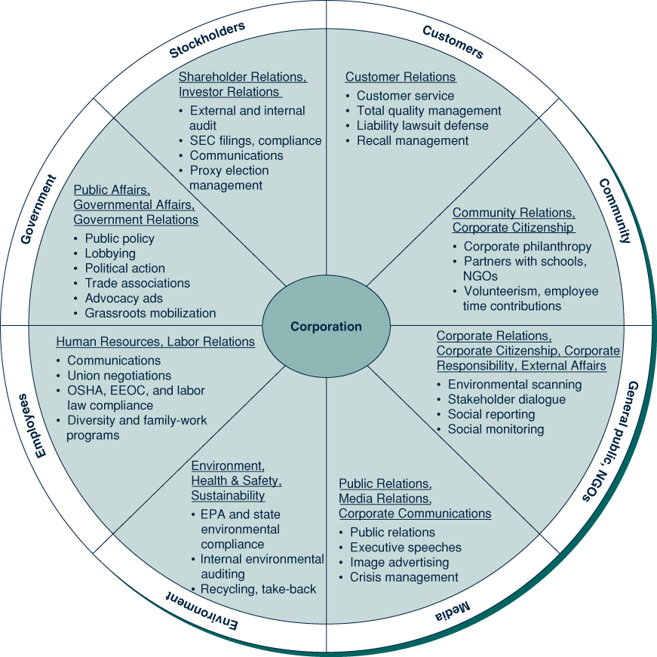
Figure 1.5
The Corporation’s Boundary Spanning Departments
1-<number>

Slide 27
The Dynamic Environment of Business
The external environment of business is dynamic and ever changing
The purpose of the firm is not simply to make a profit, but to create value for all its stakeholders – a successful business must meet both its economic and social objectives
Six dynamic forces powerfully shape the business and society relationship:
  Changing societal expectations
  Growing emphasis on ethical reasoning and actions
  Globalization
  Evolving government regulations and business response
  Dynamic natural environment
  Explosion of new technology and innovation
1-<number>

Slide 28
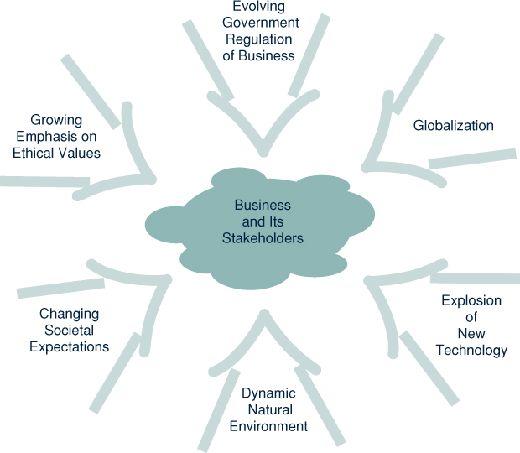
Figure 1.6
Forces that Shape the Business and Society Relationship
1-<number>

